Slide 1
International Conference
Keynote Speech
International Conference
Keynote Speech
2018年10月

Slide 2
Keynote Speech
1. Introduction
1.1. What does keynote mean?
The keynote of a speech is the main theme of a speech or the part that is emphasized the most.
1.2. What is keynote speech / keynote address?
a speech setting forth the keynote, containing a central or the most important idea
1.3. What is a keynote speaker?
a very distinguished speaker introducing the meeting or its subject

Slide 3
Keynote Speech
Tips in mind (brainstorming for sts.)
2.1. Present your main points one by one in logical order.
2.2. Pause at the end of each point (give audience time to take notes, or time to think about what you are saying).
2.3. Make it absolutely clear when you move to another point. For example:
“The next point is that …....”
2.4. Sum up what you have presented so that the audience are prepared for Question Session.

Slide 4
Keynote Speech
Notes: Attention to your body language
when delivering a keynote speech
★Eye contact
★ Facial expressions: Smiling
★ Gestures: A lively speaking style
★ Posture and body orientation: Standing erect and leaning forward

Slide 5
Keynote Speech
How to conclude
3.1. It is very important to leave your audience with a clear summary of what you have presented.
3.2. It is also important not to let the talk just fizzle out. Make it obvious that you have reached the end of the presentation.
3.3. Summarize the main points again, using phrases like:
“To sum up...”, “To conclude...”, “In summary”
3.4. Restate the purpose of your presentation:
“My research aim is to... Now it should be clear that ...”
3.5. Give thanks to the audience, and invite questions like:
“Thank you. Any questions?”

Slide 6
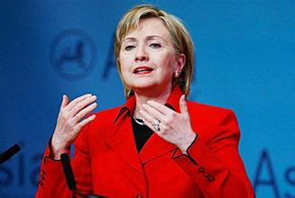
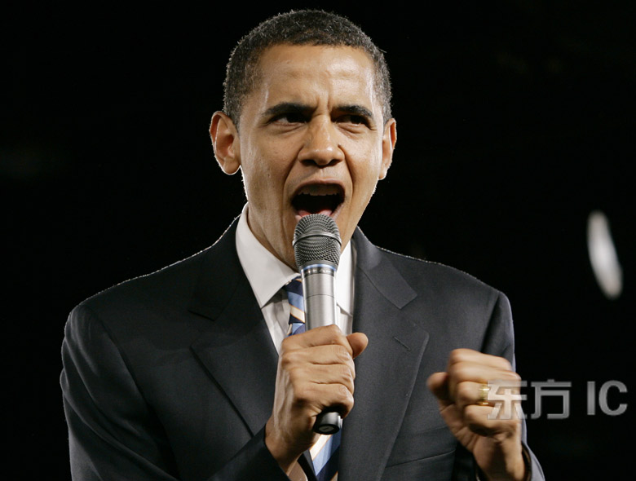
Keynote Speech
4. The Voice
Two good methods for improving your voice:
★ Simulate repeatedly some keynote speech samples.
★ Record your own voice. Practice and polish!

Slide 7
Keynote Speech
Warm reminder:
5.1. If you are not using a microphone,
speak sufficiently loudly so that the furthest member of your audience can hear clearly.
5.2. If you are using a microphone,
speak at normal volume, but a little more slowly and distinctly
5.3. Regularly sweep your eyes :
left-centre-right and back
front-middle-rear and back

Slide 8
Keynote Speech
5.4. Break your distracting habits:
e.g. “uh”, “you know”, or put the hands in pockets, or jingle the keys too often without stop.
5.5. Never apologize for your nervousness:
If you don't advertise any weaknesses in your style or content, they probably won't be noticed.
5.6. Have a very clear structure:
A good technique is to tell your audience in advance what you are going to present.

